Slide 1
Bootstrap and Qlik Sense
Kevin McGovern, Slalom
Qonnections 2016

Slide 2





Who am I?
Kevin McGovern
Slalom Consulting
mcgovey
@mcgovey
kmcgovern1

Slide 3

What is Bootstrap?
Developed at Twitter in 2010
Initially called Blueprint
Style guide for internal sites
v2 responsive
v3 mobile-first
http://getbootstrap.com/

Slide 4
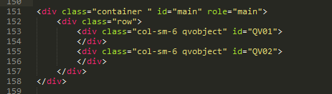
How does Bootstrap work?
CSS (Cascading Style Sheet)
For each HTML element, assign specific class that is defined in Bootstrap
JavaScript
Functions
Themes
Change standard Bootstrap styling

Slide 5
Common Bootstrap Elements
Grid
Navbar
Buttons
Typography
Tables
Modal
Alerts

Slide 6
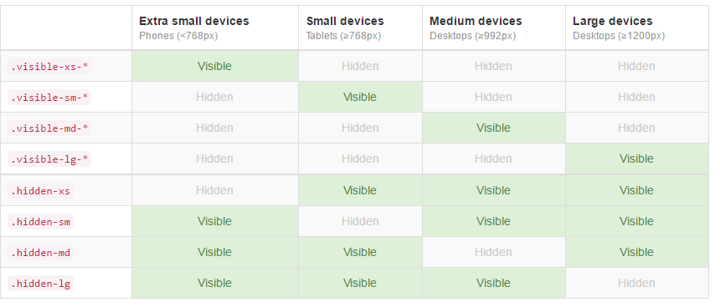
Common Bootstrap Elements (continued)
Carousel
Scrollspy
Tooltip
Icons
Show/hide based on screen size

Slide 7
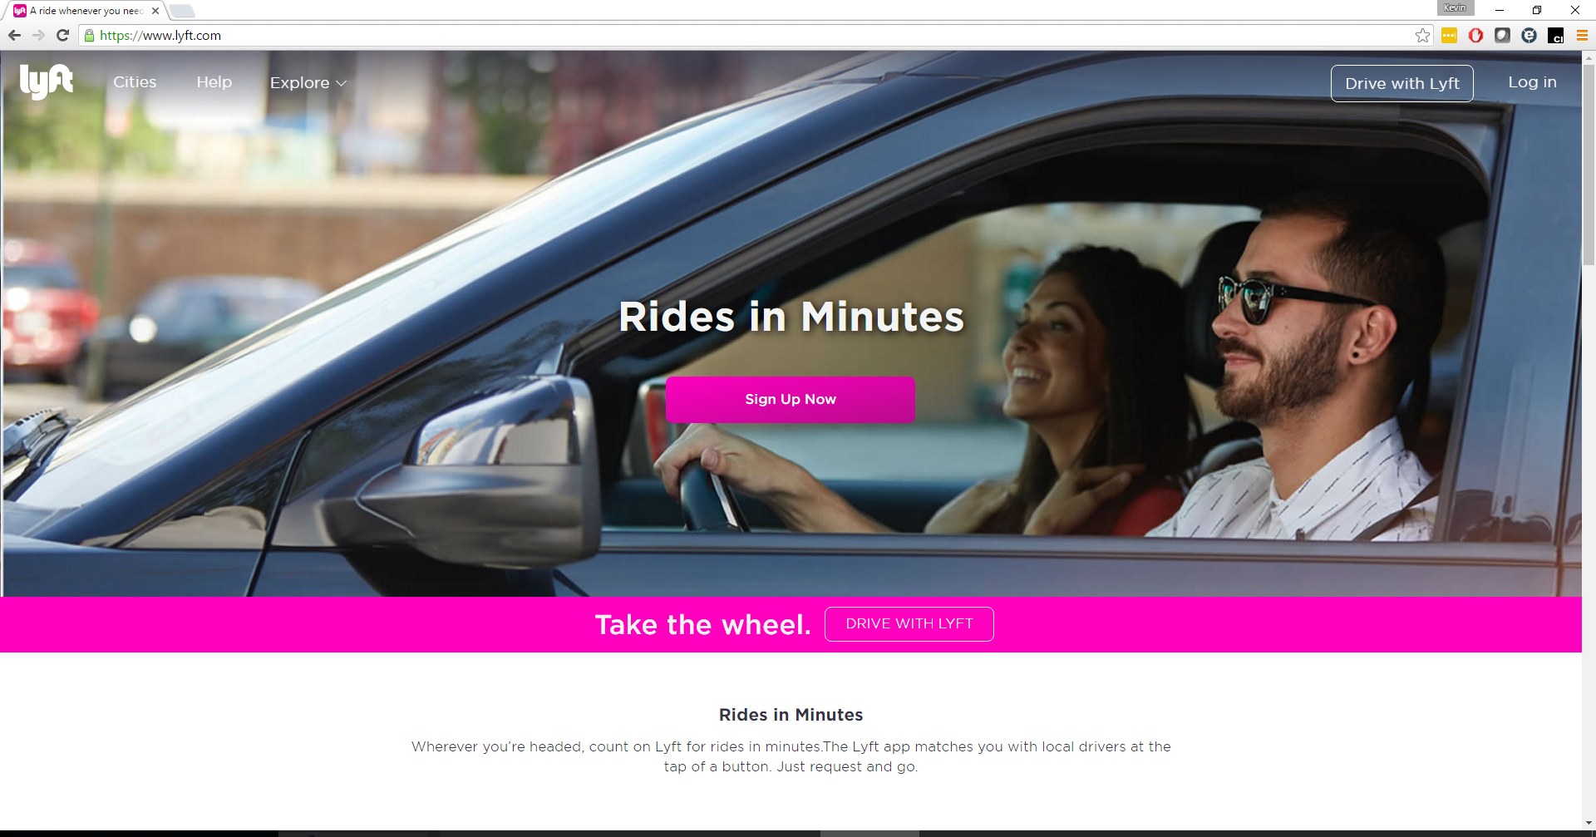
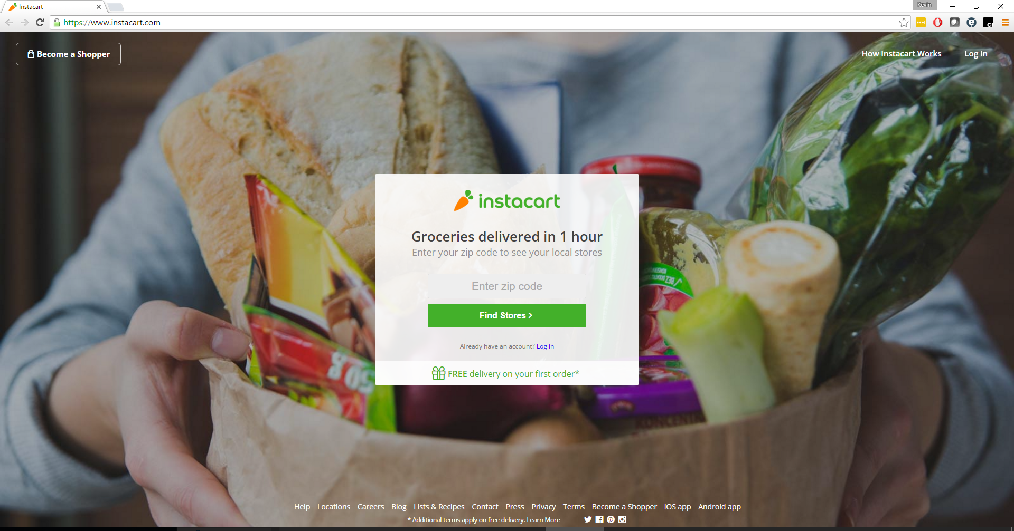
Where is Bootstrap used?

Slide 8
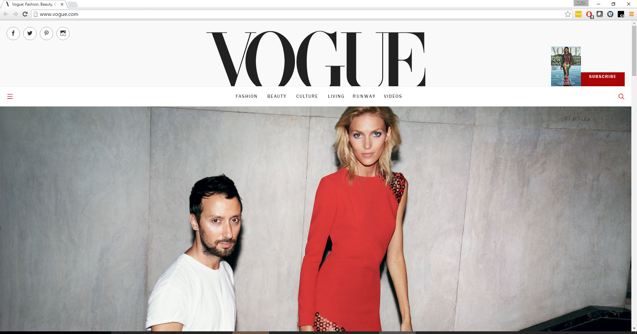
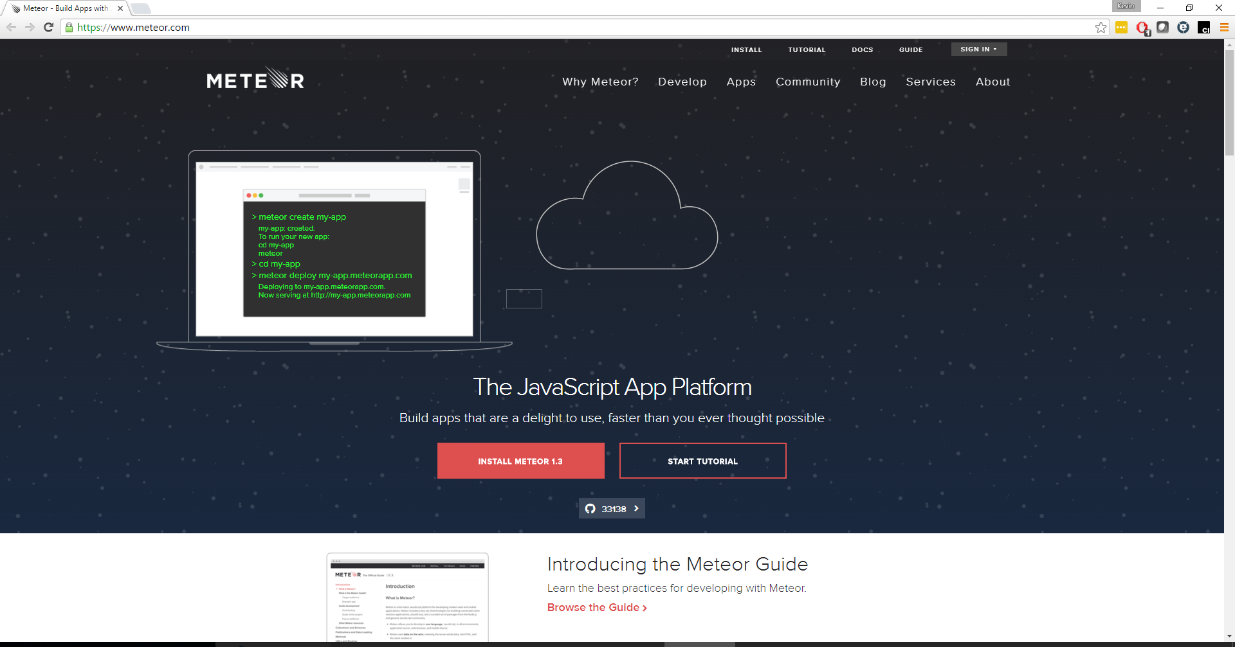

Slide 9


Slide 10
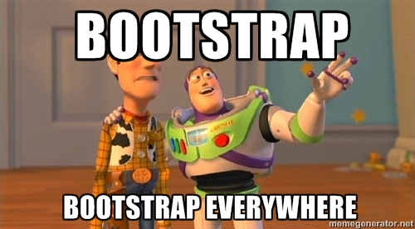

Slide 11
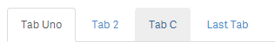
What does this have to do with Qlik Sense?
Mashups
Speed up time to build
Responsive
Included in most templates
Extensions
Add some style to your extensions

Slide 12
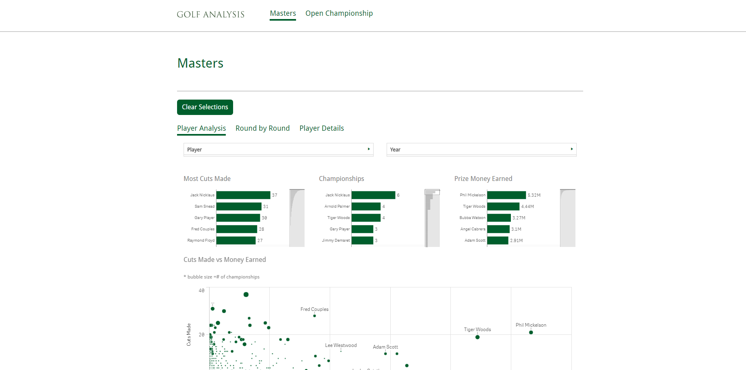
Qlik Bootstrap Mashup Example

Slide 13
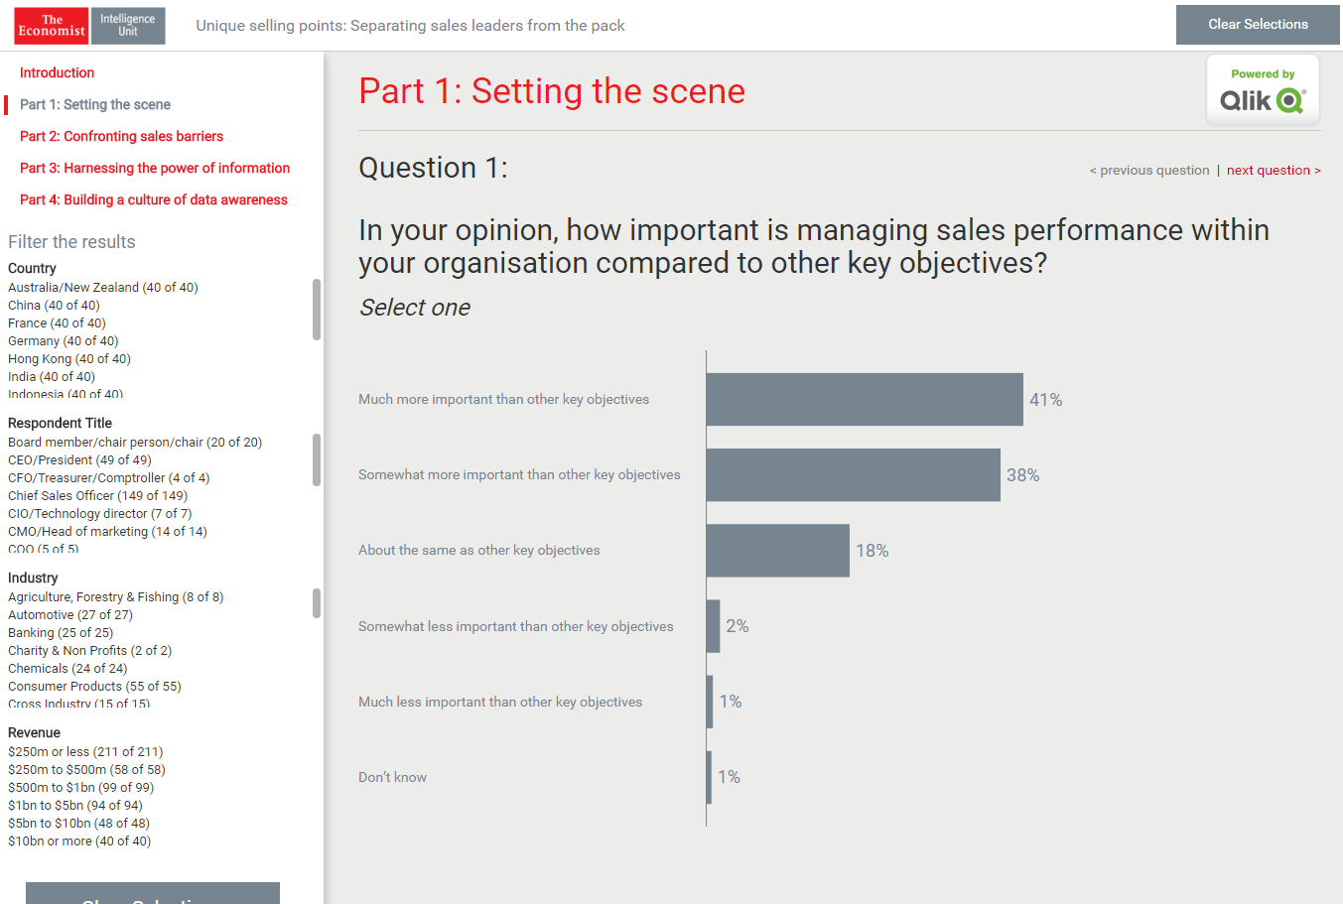
Qlik Bootstrap Mashup Example

Slide 14
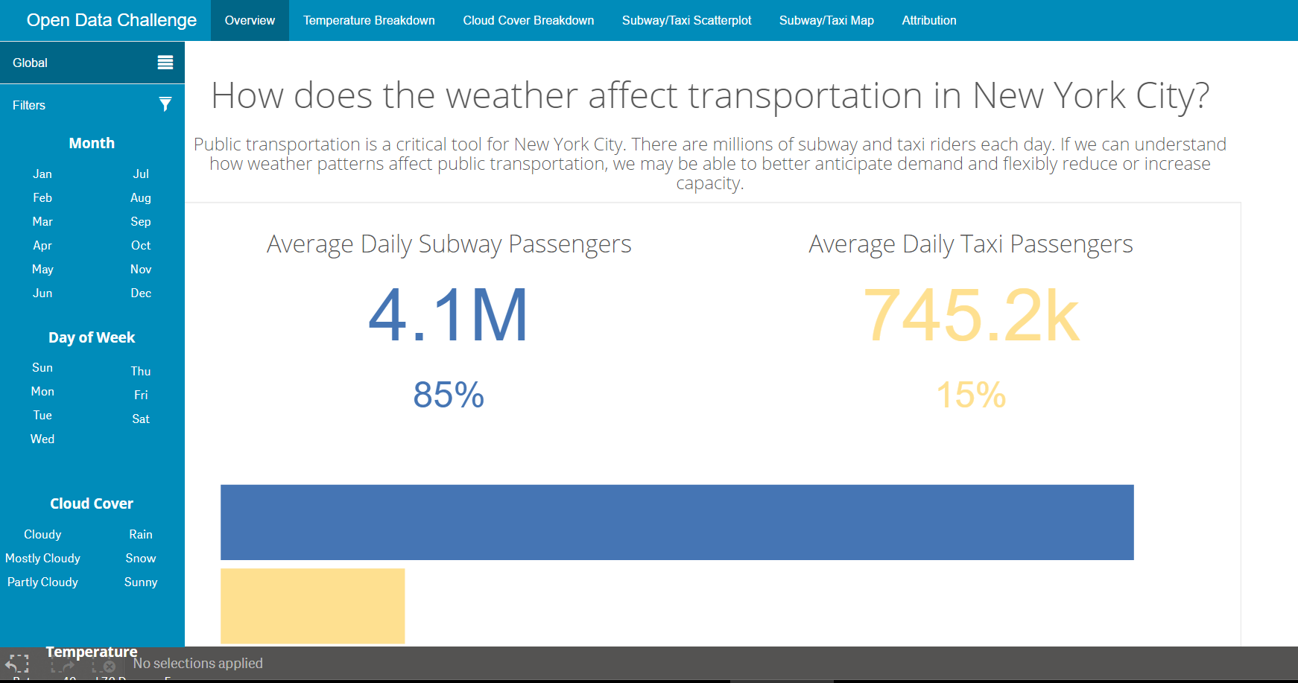
Qlik Bootstrap Mashup Example

Slide 15

Considerations before using Bootstrap
Not best for heavy transaction sites
Collision of the classes!

Slide 16
Resources
Presentation repo:
Bootstrap: http://getbootstrap.com/
W3 Schools: http://www.w3schools.com/bootstrap/
Blogpost on scoping Bootstrap
Stefan Walter Blog Post
Qlik Sense Tutorial
Scoped Bootstrap repo:
Themes: http://bootswatch.com/
Mashup demos: http://webapps.qlik.com/#/

Slide 17
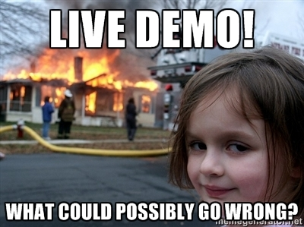

Slide 18
Presentation Steps
Slides
History
Examples
Relevance to Qlik
Show what end products of what we will build
Demo Mashup
Navbar
Grid
Formatting
Buttons
Carousel
Forms (talk)
Modal (talk)
Glyphicons (talk)
Demo Extensions
Article on scoping
What if don’t scope
Scope
MyTabs Example
Tabs Open
Finished products
Dev-hub
Hub
Carousel W3
Modal W3
Glyphicons BS
Forms BS
Article on scoping

Slide 19
Demo steps - Mashup
Create new mashup
Show native bootstrap install
Bootstrap functionality
Navbar
Grid
Formatting
Buttons
Carousel
Modal
Glyphicons

Slide 20
Demo steps - Extension
Create new extension (listbox template)
bower install bootstrap
Add to require, head statement
(add bs classes?)
npm install grunt --save-dev
npm install grunt-contrib-less --save-dev
_root.less
Build gruntfile.js
grunt
Add new header
Add new class to header
Notes:
_root.less
.bootstrap_inside { @import "./../bower_components/less/bootstrap.less"; }
Gruntfile.js
'use strict';
module.exports = function(grunt) {
grunt.initConfig({
less: {
bootstrap: {
files: {
"./output/scoped-bootstrap.css": "./less/_root.less"
}
}
}
});
grunt.loadNpmTasks('grunt-contrib-less');
grunt.registerTask('default', ['less']);
};

Slide 21
TOC
X- What is Bootstrap
X- Why it was created and benefits
X- Created by Twitter for internal sites
X- Standard and fast website creation
X- Responsive
X- Package many features critical to site creation
Where is it used
examples
X- What version should we use
Where can you go to learn more about it
How does it relate to QS
Use in extensions
X- Verify that conflicts still exist
Use in mashups
Check which templates its included in
Show some demo examples
Show end product first
Live demo with static files created ahead of time
Key components of Bootstrap
Grid system
Carousel
Nav
Button
Forms
Icons (check licensing)
Typography
Tabs
Modals
Show mashup
Show where to download scoped bootstrap file

